Slide 1
Cucumber
2025

Slide 2
TDD and BDD
Behavior-Driven Development (BDD) and Test-Driven Development (TDD) are two prominent methodologies in software development, each with distinct approaches and objectives.
Both aim to improve software quality through testing, but they differ in focus, collaboration, and implementation.

Slide 3
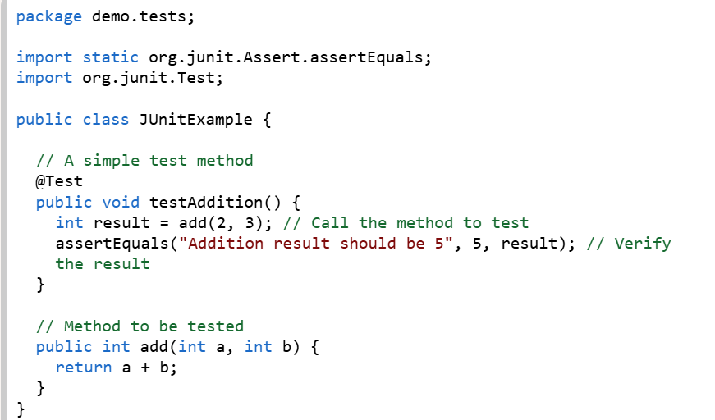
TDD and BDD
Test-Driven Development (TDD)
TDD focuses on unit testing and the implementation of specific features. Developers write test cases first, which initially fail, and then implement the minimal code required to pass these tests. Once the tests pass, the code is refactored for optimization. Tools like JUnit, NUnit, and PyTest are widely used in TDD.
TDD is primarily a developer-centric practice, emphasizing code correctness and ensuring high test coverage. It is well-suited for projects involving APIs or third-party integrations.

Slide 4
TDD and BDD
Behavior-Driven Development (BDD): BDD extends TDD by by focusing on system behavior and collaboration.
BDD emphasizes system behavior from the end-user's perspective. It involves collaboration between developers, testers, and stakeholders to define application behavior in plain English using scenarios. These scenarios are typically written in a "Given-When-Then" format, making them accessible to non-technical team members. Tools like Cucumber and SpecFlow are commonly used in BDD.
The process begins with defining behaviors, followed by writing automated scripts, implementing functional code, and verifying the behavior

Slide 5
TDD and BDD
Aspect | TDD (Test-Driven Development) | BDD (Behavior-Driven Development)
Focus | Code correctness (unit level) | System behavior (user perspective)
Language | Programming language tests | Plain language (Gherkin syntax)
Stakeholders | Developers | Developers, testers, business users
Process | Write test → Write code → Refactor | Define behavior → Write scenarios → Implement
Benefits | Early bug detection, clean code | Shared understanding, better collaboration
Limitations | Can be too technical for non-devs | Requires more upfront collaboration

Slide 6
TDD and BDD
⚖️ When to Use Each
Use TDD when:
You need strong unit-level validation.
The team is developer-heavy and focused on technical correctness.
Rapid iterations and refactoring are expected.
Use BDD when:
Business stakeholders need to be involved in defining requirements.
You want executable specifications that double as documentation.
Complex systems require clear communication of expected behaviors.

Slide 7
Cucumber
Cucumber is framework/tool which supports the implementation of BDD.
Cucumber supports different languages like JAVA,PYTHON,.NET, PHP, JAVASCRIPT, PERL and so on..
BDD tools are SpecFlow,Behave,Jasmine, Jbehave, Kahalan, Daspec, spock,LestLeft and more.

Slide 8
Important files in Cucumber
Feature file
Step Definition
Runner files

Slide 9
Feature File
Gherkin Syntax
Feature files are written using Gherkin, a business-readable, domain-specific language. Gherkin uses keywords like Feature, Scenario, Given, When, Then, And, and But to structure the specifications.
File Extension
Feature files are typically saved with a .feature extension (e.g., login.feature, search.feature).

Slide 10
Feature File
Feature: The file begins with the Feature: keyword, followed by a descriptive name for the feature being tested. An optional free-form description can be added below the feature name.
Scenario: A concrete example of how the feature should behave. Within a feature, you can add one or more Scenario blocks. Each scenario describes a particular sequence of events and expected outcomes.
Steps (Given-When-Then): Scenarios are composed of steps using the Given-When-Then structure:
Given: Describes the initial state or prerequisites before the action.
When: Describes the action or event being performed.
Then: Describes the expected outcome or result after the action.
Background: An optional Background: section can be used to define common Given steps that apply to all scenarios within a feature, reducing repetition.
Scenario Outline: Used for data-driven testing with multiple inputs.
Tags: Tags (e.g., @smoke, @regression) can be added above Feature or Scenario to categorize and filter tests for execution.

Slide 11
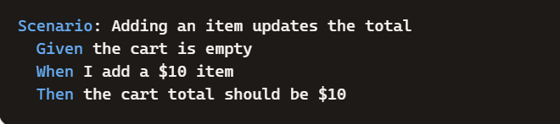
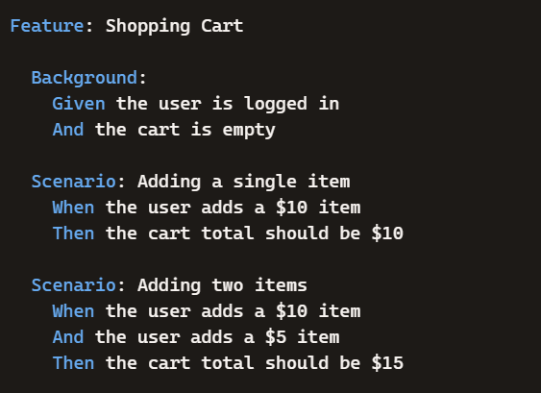
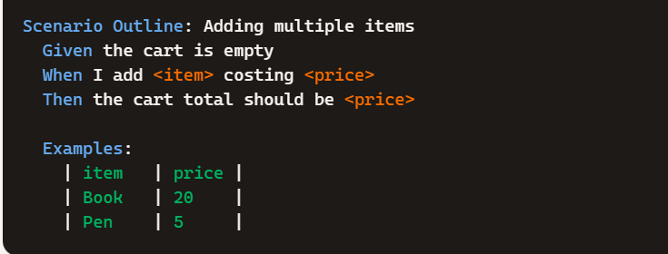
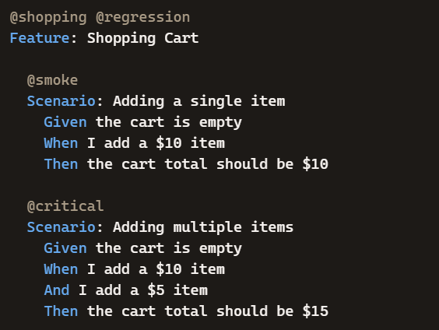
Keywords
Background:
Scenario:
Scenario Outline:
Tags:

Slide 12
Step Definition
A step definition in BDD is the piece of code that connects the plain-language steps written in a feature file (Gherkin syntax) to actual executable test logic. It acts as the translator between human-readable scenarios and automated test code.
What Step Definitions Do
Bridge the gap: They map natural language steps (Given–When–Then) to programming code.
Executable logic: When a scenario runs, the framework (like Cucumber, SpecFlow, JBehave) matches each step to its corresponding step definition and executes the code.
Reusable components: Step definitions can be reused across multiple scenarios, reducing duplication.

Slide 13
Step Definition
Step Definition
import io.cucumber.java.en.*;
public class LoginSteps {
@Given("the user is on the login page")
public void userOnLoginPage() {
// Code to open login page
}
@When("they enter valid credentials")
public void enterValidCredentials() {
// Code to input username and password
}
@Then("they should see the dashboard")
public void seeDashboard() {
// Code to verify dashboard is displayed
}
}
Feature File
Feature: Login
Scenario: Successful login
Given the user is on the login page
When they enter valid credentials
Then they should see the dashboard

Slide 14
Runner File
Configuration:
It provides a place to configure various aspects of your Cucumber test run using @CucumberOptions annotations, such as:
features: Specifies the path to your feature files.
glue: Specifies the package where your step definition classes are located.
plugin: Defines how test reports are generated (e.g., HTML, JSON, pretty console output).
taAllows you to filter scenarios to run based on their tags (e.g., @SmokeTest, @Regression).gs:
dryRun: Checks for missing step definitions without actually executing the steps.
Integration with Test Frameworks: It integrates Cucumber with your chosen test framework (e.g., by using @RunWith(Cucumber.class) for JUnit).

Slide 15
Project Structure
cucumber-selenium-demo/
│
├── src
│ └── test
│ └── java
│ ├── stepDefinitions
│ │ └── LoginSteps.java
│ ├── runners
│ │ └── TestRunner.java
│ └── pages
│ └── LoginPage.java
│
└── src
└── test
└── resources
└── features
└── login.feature

Slide 16
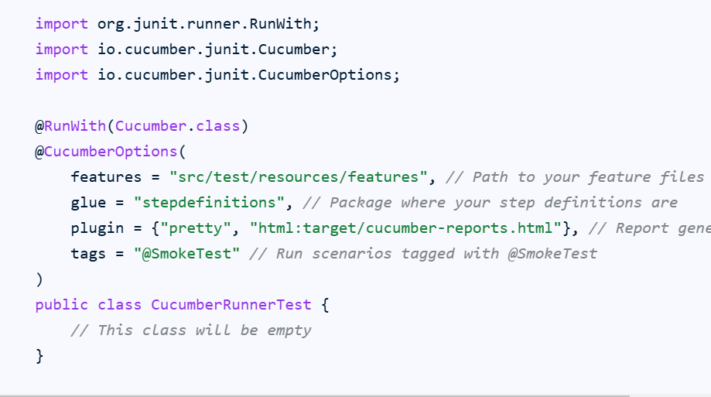

Slide 17
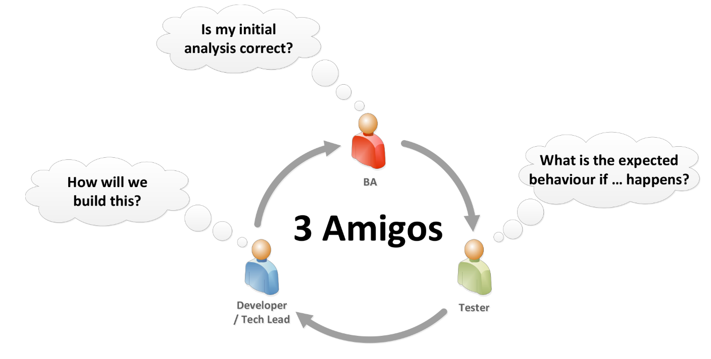
Three amigos

Slide 18
Cucumber hooks
Cucumber hooks are code blocks, defined with annotations like @Before and @After, that run automatically before and after each scenario or step, respectively, to manage setup and teardown tasks
Key Annotations
@Before: Executes before each scenario.
@After: Executes after each scenario.
@BeforeStep: Executes before each step in a scenario.
@AfterStep: Executes after each step in a scenario.

Slide 19
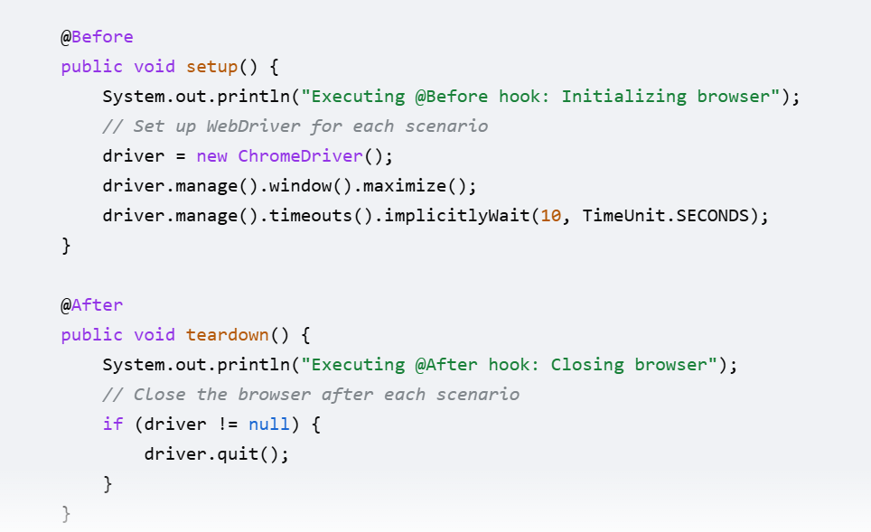

Slide 20
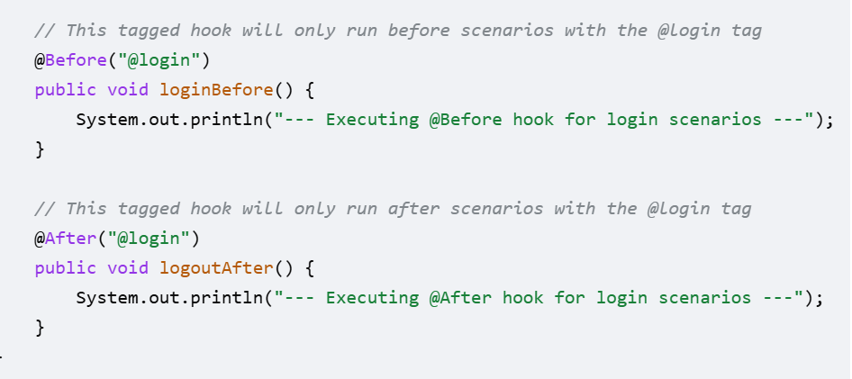
Tagged Hooks
Tagged hooks only run for scenarios that have a matching tag. This is useful for scenarios that require special setup

